Slide 1
Методы вычитания фона
Расстояние Евклида, смесь Гауссиан, ViBe, PBAS

Slide 2
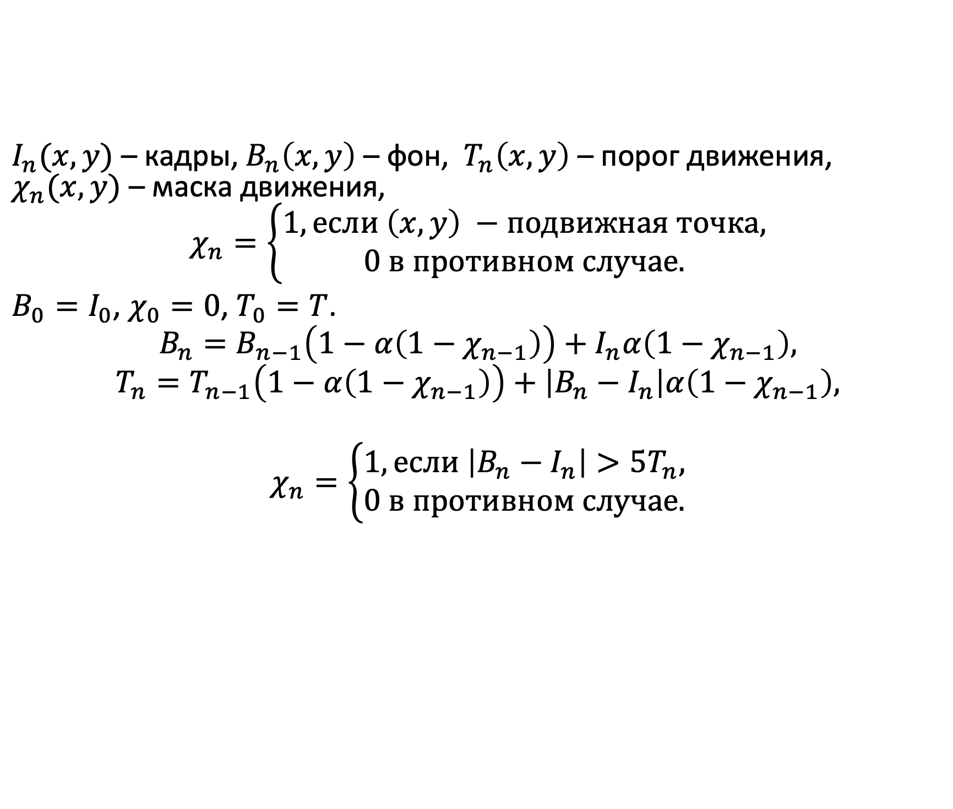
Накопление фона скользящим средним
$I_{n}(x,y)$ – кадры, $B_{n}\left(x,y\right)$ – фон, $T_{n}\left(x,y\right)$ – порог движения, $χ_{n}(x,y)$ – маска движения,
$$χ_{n}=\left\{\begin{aligned}1, если \left(x,y\right) −подвижная точка, \\ 0 в противном случае.\end{aligned}\right.$$
$B_{0}=I_{0}$, $χ_{0}=0$, $T_{0}=T$.
$$B_{n}=B_{n−1}\left(1−α\left(1−χ_{n−1}\right)\right)+I_{n}α\left(1−χ_{n−1}\right),$$
$$T_{n}=T_{n−1}\left(1−α\left(1−χ_{n−1}\right)\right)+\left|B_{n}−I_{n}\right|α\left(1−χ_{n−1}\right),$$
$$χ_{n}=\left\{\begin{aligned}1, если \left|B_{n}−I_{n}\right|>5T_{n}, \\ 0 в противном случае.\end{aligned}\right.$$

Slide 3
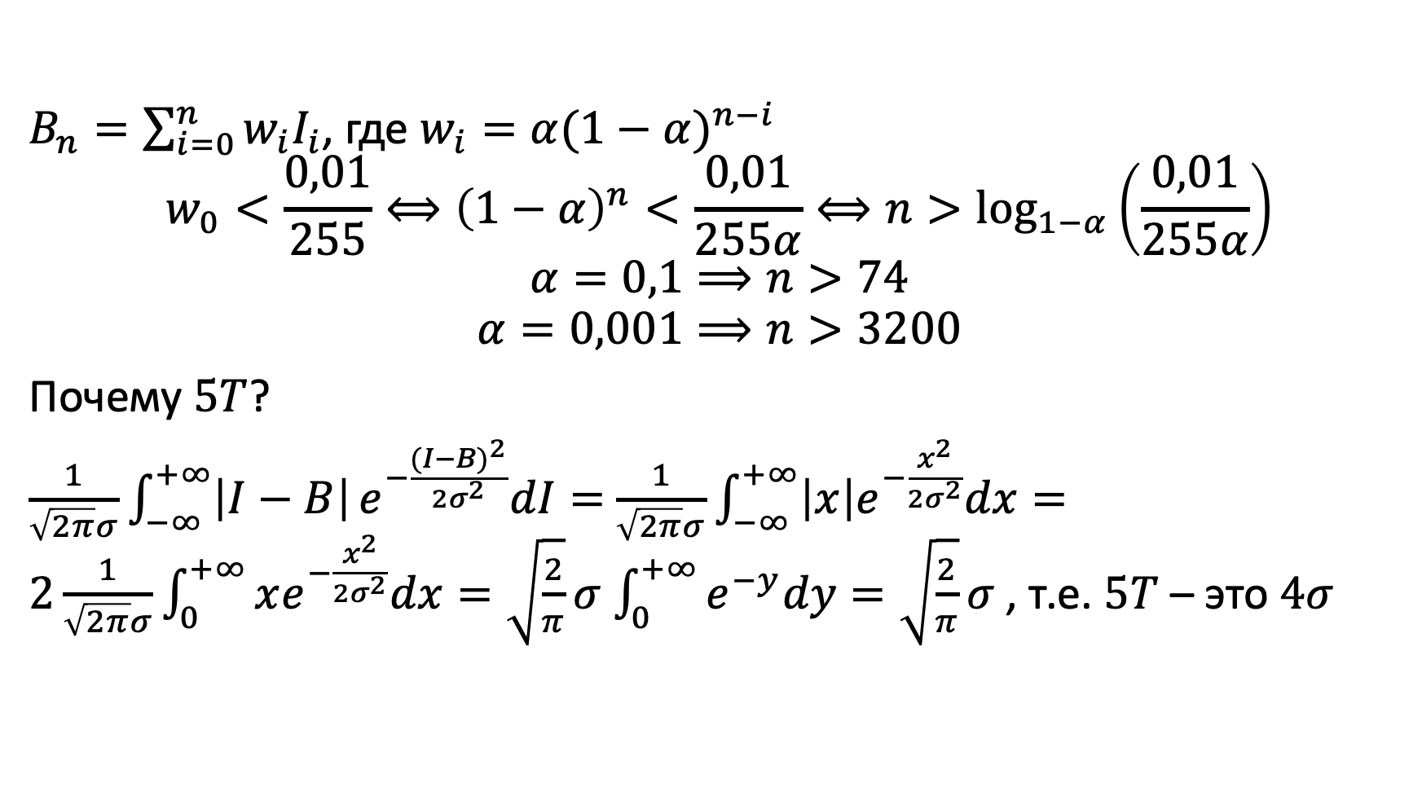
Анализ накопления скользящим средним
$B_{n}=\sum_{i=0}^{n}{w_{i}I_{i}}$, где $w_{i}=α{(1−α)}^{n−i}$
$$w_{0}<\frac{0,01}{255}⟺{\left(1−α\right)}^{n}<\frac{0,01}{255α}⟺n>\log_{1−α}\left(\frac{0,01}{255α}\right)$$
$$α=0,1⟹n>74$$
$$α=0,001⟹n>3200$$
Почему $5T$?
$\frac{1}{\sqrt{2π}σ}\int_{−∞}^{+∞}{\left|I−B\right|}e^{−\frac{{(I−B)}^{2}}{2σ^{2}}}dI=$ $\frac{1}{\sqrt{2π}σ}\int_{−∞}^{+∞}{\left|x\right|e^{−\frac{x^{2}}{2σ^{2}}}dx}=2\frac{1}{\sqrt{2π}σ}\int_{0}^{+∞}{xe^{−\frac{x^{2}}{2σ^{2}}}dx}=\sqrt{\frac{2}{π}}σ$ $\int_{0}^{+∞}{e^{−y}dy}=\sqrt{\frac{2}{π}}σ$ , т.е. $5T$ – это $4σ$

Slide 4
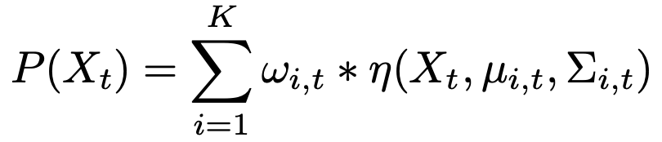
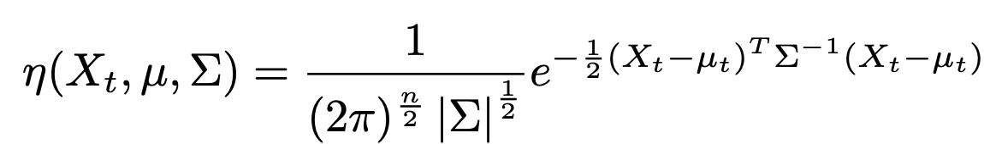
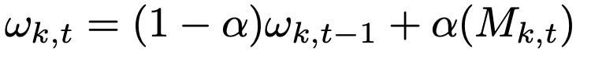
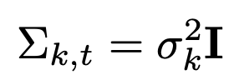
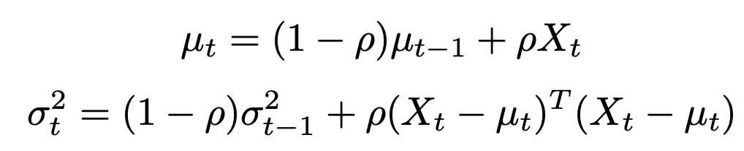
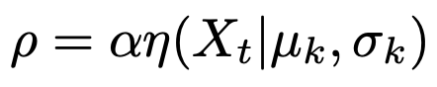
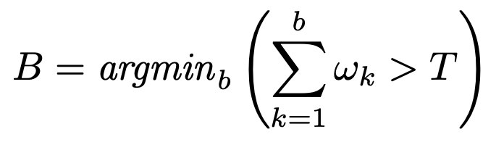
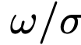
Смесь гауссиан
Упорядочиваем моды по , фон – это первые гауссиан
Stauffer, Chris, and W. Eric L. Grimson. "Adaptive background mixture models for real-time tracking." In Proceedings. 1999 IEEE Computer Society Conference on Computer Vision and Pattern Recognition (Cat. No PR00149), vol. 2, pp. 246-252. IEEE, 1999. http://mesh.brown.edu/en193s05-2004/pdfs/StaufferGrimson-cvpr98.pdf

Slide 5
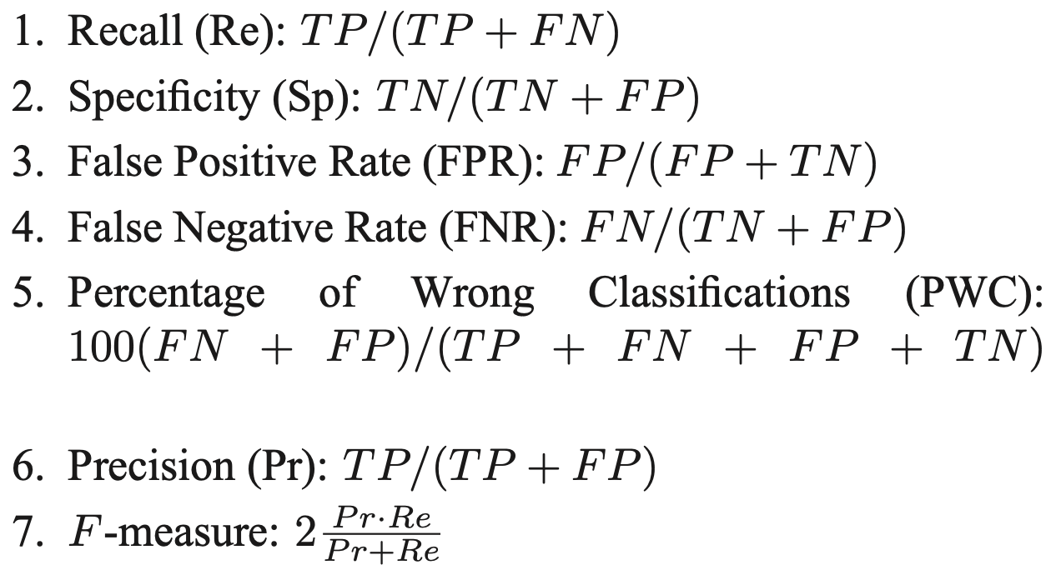
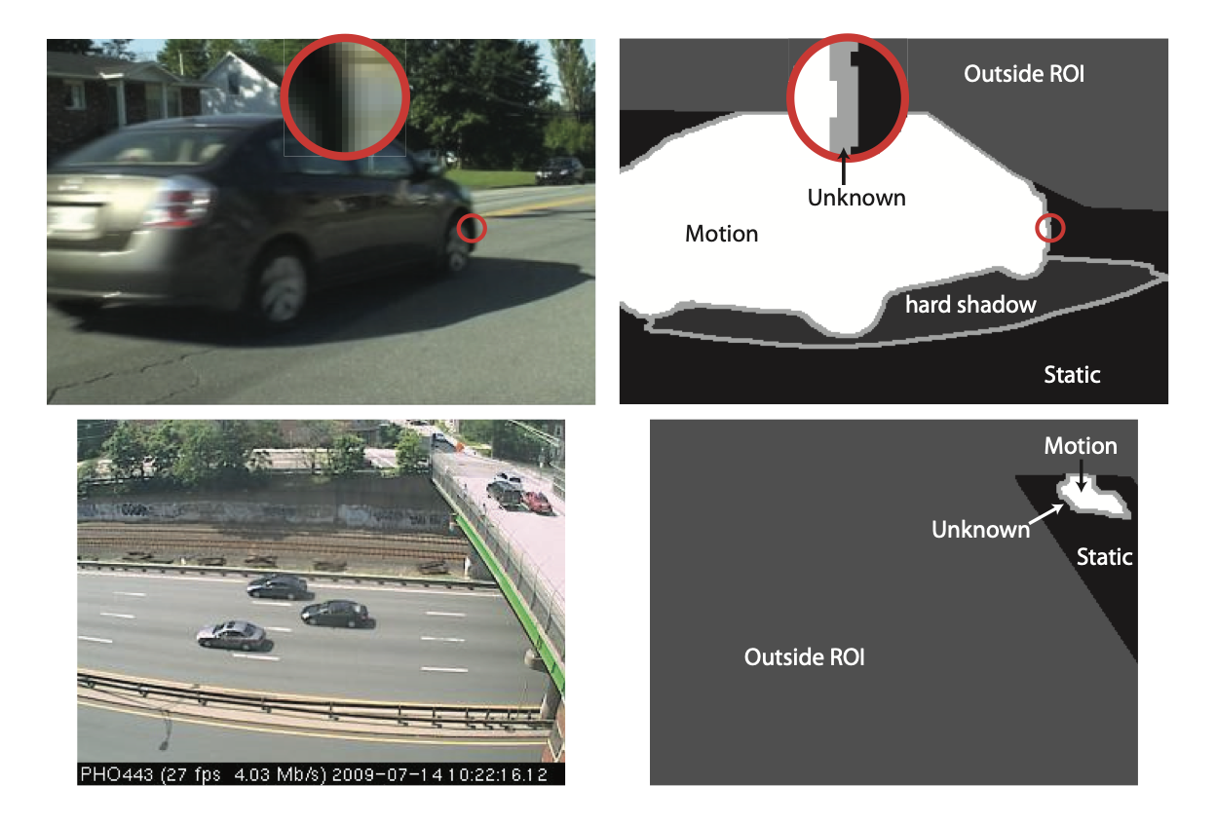
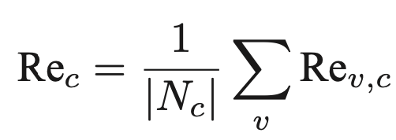
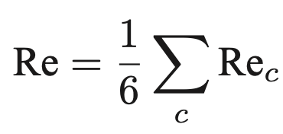
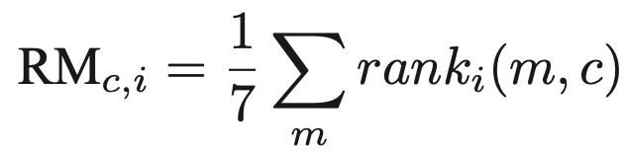
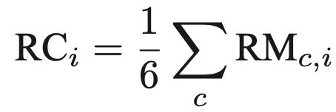
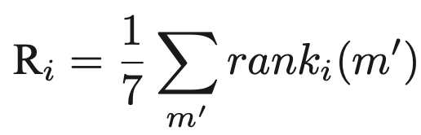
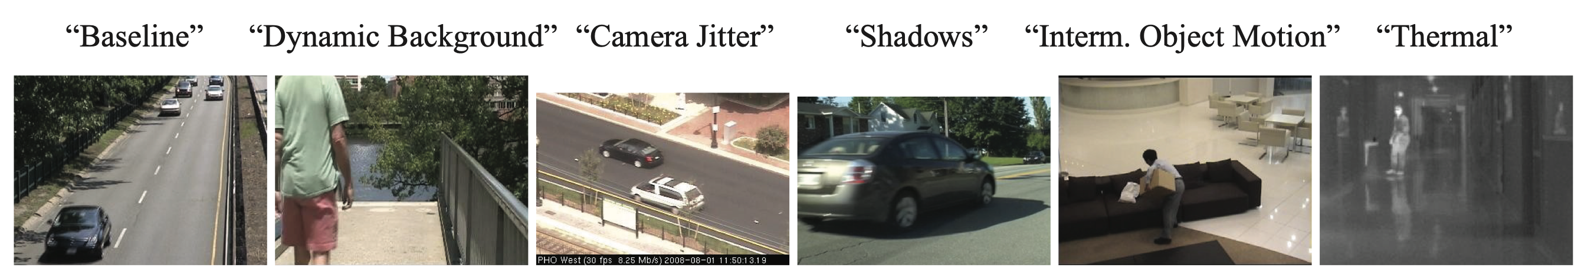
changedetection.org
Goyette, Nil, Pierre-Marc Jodoin, Fatih Porikli, Janusz Konrad, and Prakash Ishwar. "Changedetection. net: A new change detection benchmark dataset." In 2012 IEEE computer society conference on computer vision and pattern recognition workshops, pp. 1-8. IEEE, 2012. https://www.merl.com/publications/docs/TR2012-044.pdf

Slide 6
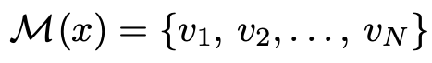
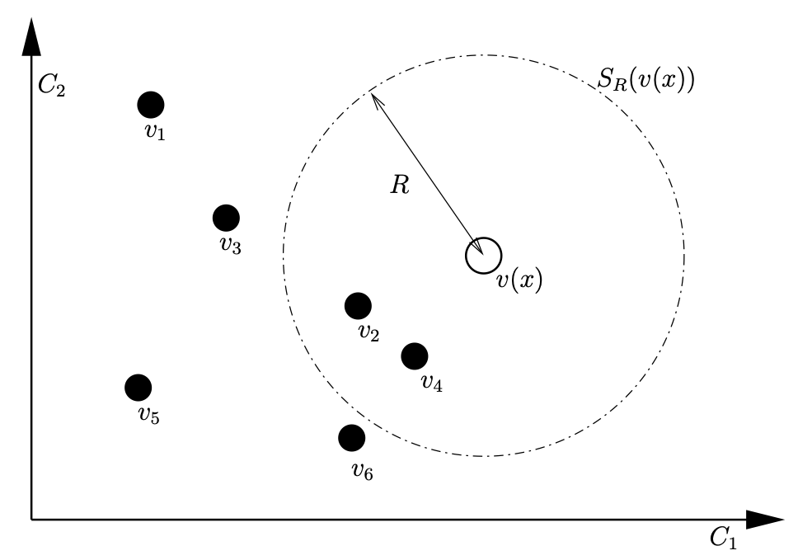
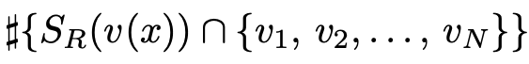
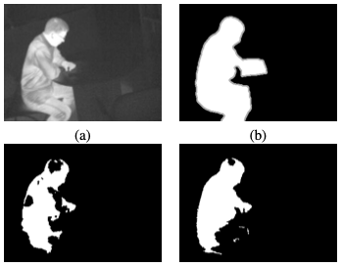
ViBe
Van Droogenbroeck, Marc, and Olivier Paquot. "Background subtraction: Experiments and improvements for ViBe." In 2012 IEEE computer society conference on computer vision and pattern recognition workshops, pp. 32-37. IEEE, 2012. https://www.researchgate.net/profile/Marc_Droogenbroeck/publication/252067585_Background_Subtraction_Experiments_and_Improvements_for_ViBe/links/553a5bce0cf29b5ee4b626d0/Background-Subtraction-Experiments-and-Improvements-for-ViBe.pdf

Slide 7
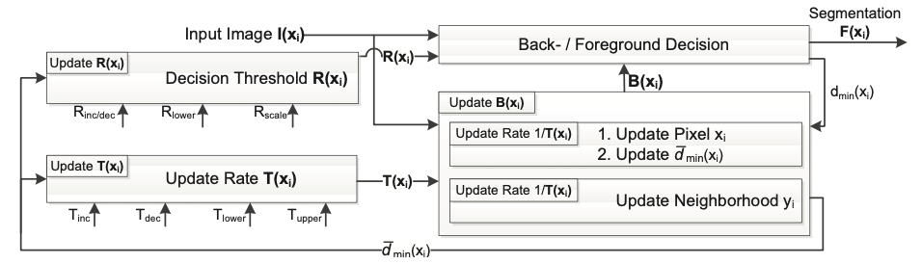
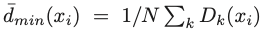
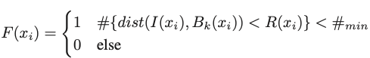
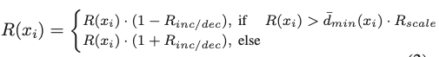
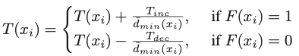
PBAS
Hofmann, Martin, Philipp Tiefenbacher, and Gerhard Rigoll. "Background segmentation with feedback: The pixel-based adaptive segmenter." In 2012 IEEE computer society conference on computer vision and pattern recognition workshops, pp. 38-43. IEEE, 2012. https://mediatum.ub.tum.de/doc/1137859/file.pdf

Slide 8
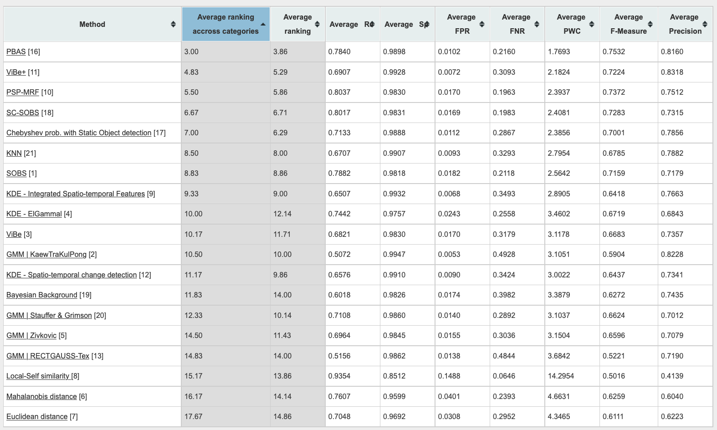
Changedetection 2012

Slide 9
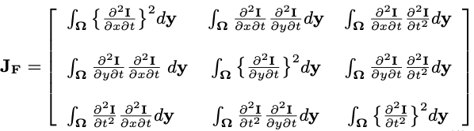
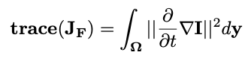
FTSG (Flux Tensor with Split Gaussian models)
Wang, Rui, Filiz Bunyak, Guna Seetharaman, and Kannappan Palaniappan. "Static and moving object detection using flux tensor with split gaussian models." In Proceedings of the IEEE Conference on Computer Vision and Pattern Recognition Workshops, pp. 414-418. 2014. https://www.cv-foundation.org/openaccess/content_cvpr_workshops_2014/W12/papers/Wang_Static_and_Moving_2014_CVPR_paper.pdf

Slide 10
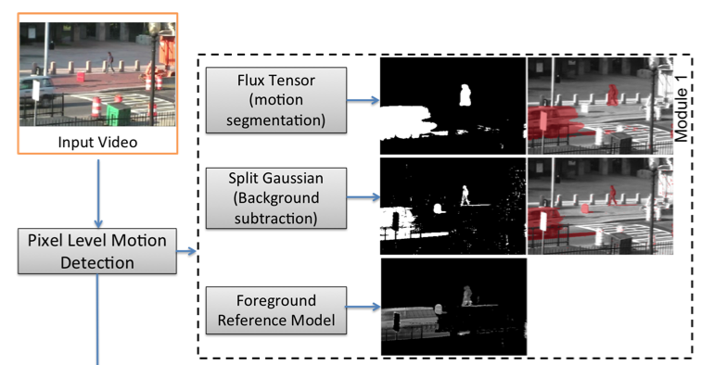
FTSG (Flux Tensor with Split Gaussian models)

Slide 11
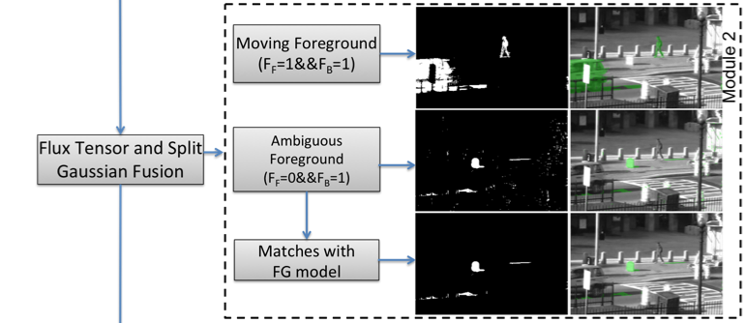
FTSG (Flux Tensor with Split Gaussian models)

Slide 12
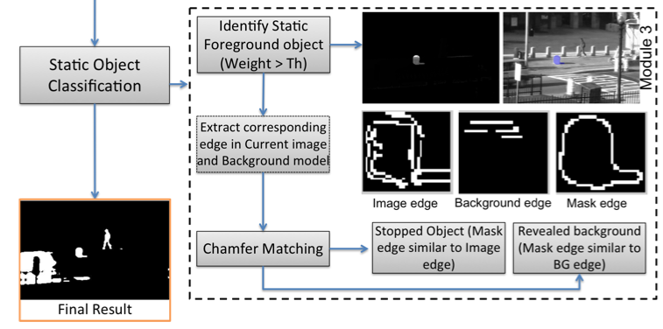
FTSG (Flux Tensor with Split Gaussian models)

Slide 13
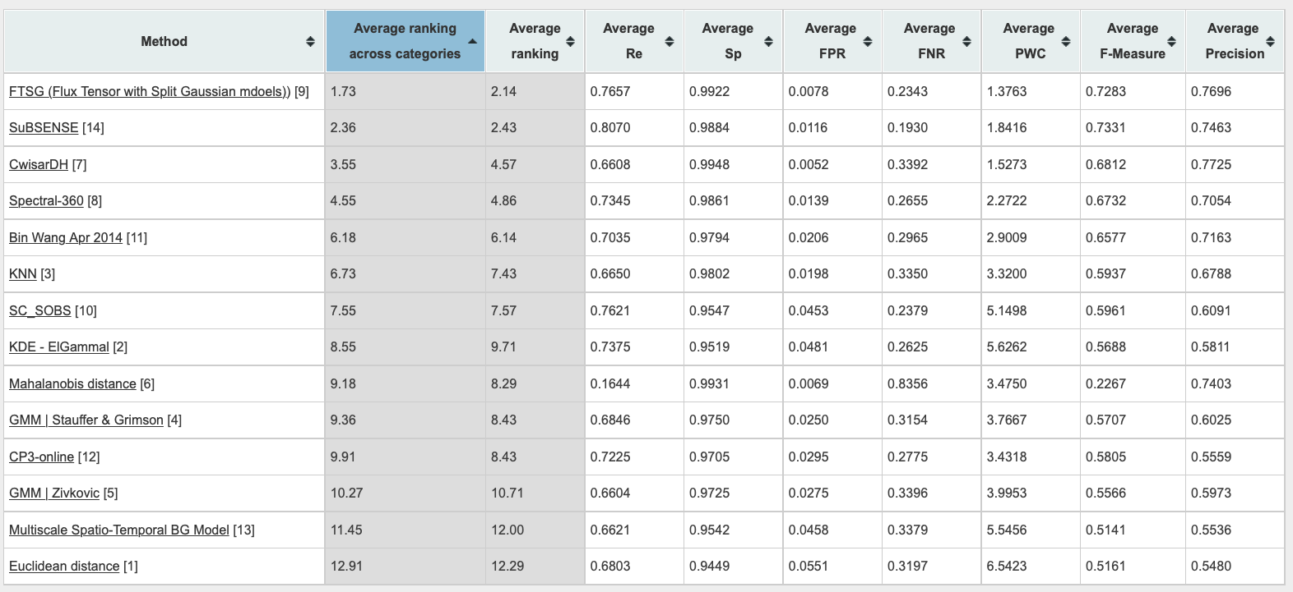
Changedetection 2014

Slide 14
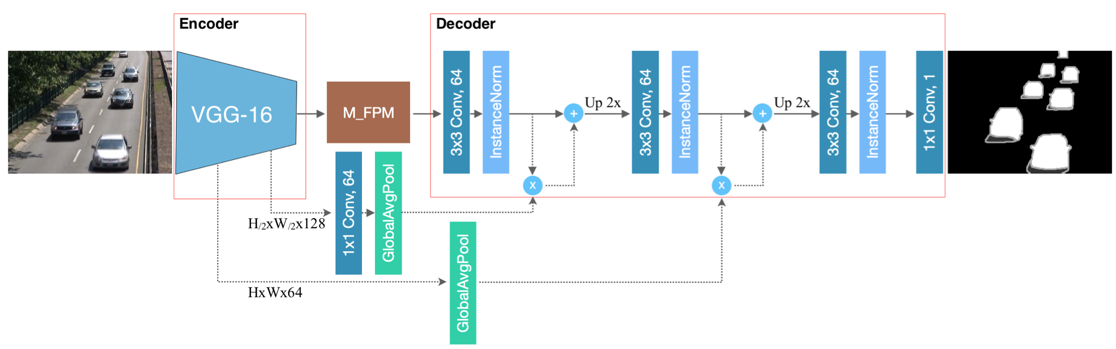
Multi-scale Features for Foreground Segmentation FgSegNet_v2
Lim, Long Ang, and Hacer Yalim Keles. "Learning multi-scale features for foreground segmentation." Pattern Analysis and Applications (2019): 1-12. https://arxiv.org/pdf/1808.01477

Slide 15
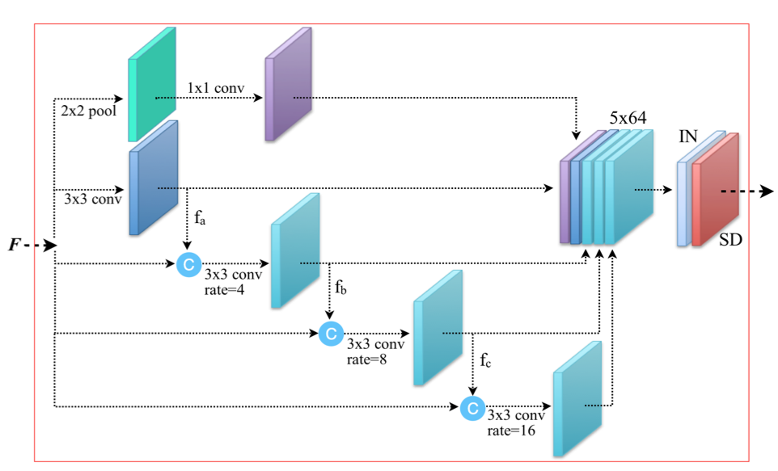
FgSegNet_v2

Slide 16
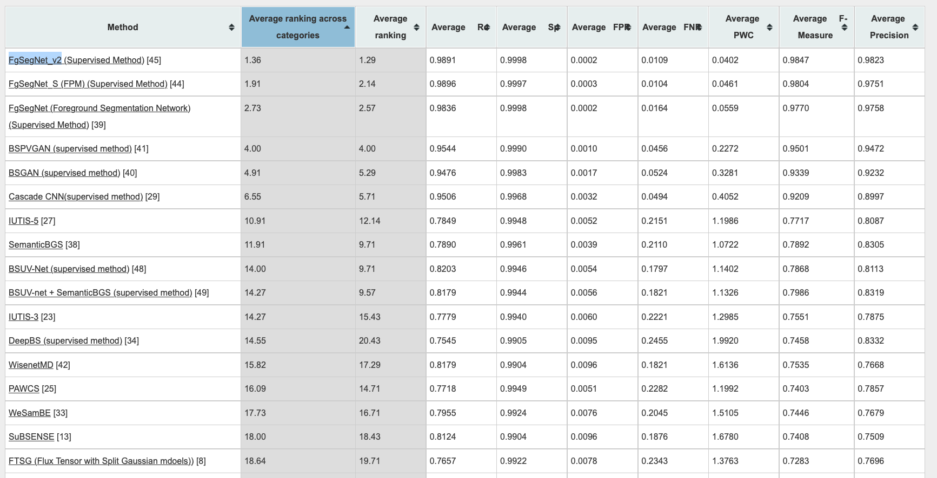
ChangeDetection 2020

Slide 17
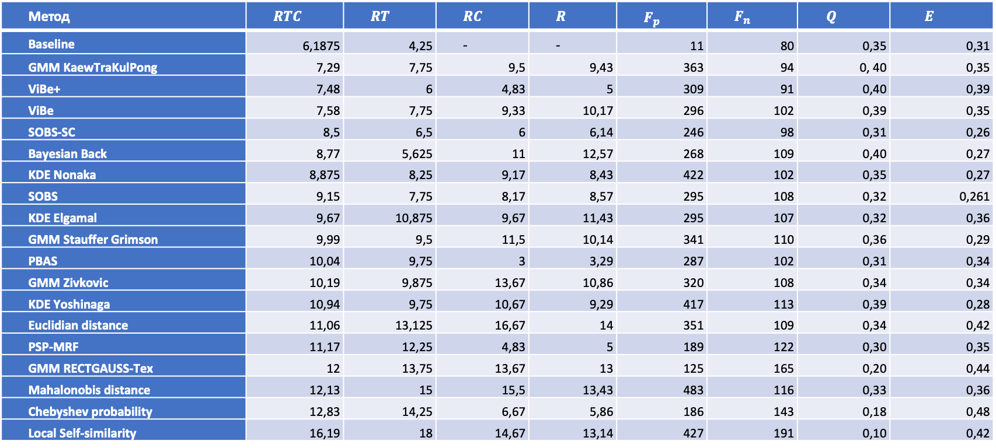
Взаимосвязь результатов сегментации с качеством отслеживания подвижных объектов
Метод | $$RTC$$ | $$RT$$ | $$RC$$ | $$R$$ | $$F_{p}$$ | $$F_{n}$$ | $$Q$$ | $$E$$
Baseline | 6,1875 | 4,25 | - | - | 11 | 80 | 0,35 | 0,31
GMM KaewTraKulPong | 7,29 | 7,75 | 9,5 | 9,43 | 363 | 94 | 0, 40 | 0,35
ViBe+ | 7,48 | 6 | 4,83 | 5 | 309 | 91 | 0,40 | 0,39
ViBe | 7,58 | 7,75 | 9,33 | 10,17 | 296 | 102 | 0,39 | 0,35
SOBS-SC | 8,5 | 6,5 | 6 | 6,14 | 246 | 98 | 0,31 | 0,26
Bayesian Back | 8,77 | 5,625 | 11 | 12,57 | 268 | 109 | 0,40 | 0,27
KDE Nonaka | 8,875 | 8,25 | 9,17 | 8,43 | 422 | 102 | 0,35 | 0,27
SOBS | 9,15 | 7,75 | 8,17 | 8,57 | 295 | 108 | 0,32 | 0,261
KDE Elgamal | 9,67 | 10,875 | 9,67 | 11,43 | 295 | 107 | 0,32 | 0,36
GMM Stauffer Grimson | 9,99 | 9,5 | 11,5 | 10,14 | 341 | 110 | 0,36 | 0,29
PBAS | 10,04 | 9,75 | 3 | 3,29 | 287 | 102 | 0,31 | 0,34
GMM Zivkovic | 10,19 | 9,875 | 13,67 | 10,86 | 320 | 108 | 0,34 | 0,34
KDE Yoshinaga | 10,94 | 9,75 | 10,67 | 9,29 | 417 | 113 | 0,39 | 0,28
Euclidian distance | 11,06 | 13,125 | 16,67 | 14 | 351 | 109 | 0,34 | 0,42
PSP-MRF | 11,17 | 12,25 | 4,83 | 5 | 189 | 122 | 0,30 | 0,35
GMM RECTGAUSS-Tex | 12 | 13,75 | 13,67 | 13 | 125 | 165 | 0,20 | 0,44
Mahalonobis distance | 12,13 | 15 | 15,5 | 13,43 | 483 | 116 | 0,33 | 0,36
Chebyshev probability | 12,83 | 14,25 | 6,67 | 5,86 | 186 | 143 | 0,18 | 0,48
Local Self-similarity | 16,19 | 18 | 14,67 | 13,14 | 427 | 191 | 0,10 | 0,42
Я.Я. Петричкович, А.В. Хамухин. Анализ влияния метода вычитания фона на конечную эффективность систем компьютерного зрения. https://github.com/anakham/MIET.AI.Course/blob/master/Лекция%208/impact_of_bg_substraction.pdf

